Slide 1

Can C, C++ and VC++ be containerized?
Notes:
Can C, C++ and VC++ Applications be containerized ?
Before answering this question
Lets understand, why C and C++ application is required?

Slide 2
Purpose of C, C++ APPs
1
Operating Systems
C and C++ language has been an integral part of the development of multiple operating systems like Unix etc.
2
Development of New Languages
C directly or indirectly influencing development of many languages including C++ which is C with classes, C#, D, Java, Limbo, JavaScript, Perl, UNIX’s C Shell, PHP and Python, and Verilog
3
Embedded Systems
C and C++ language an optimum choice for scripting applications and drivers of embedded systems.
4
Graphics and Games
C and C++ language has been used in the development of a variety of graphics and gaming applications, such as chess, bouncing ball, archery.
Notes:
C and C++ language assists in creating many operating systems like, Unix etc.
C and C++ language also helps in generating new user friendly languages like C#, Java, Perl, PHP and Python etc.
C and C++ Language facilitates in creation of drivers for embedded systems
C and C++ language also accelerates the development of many graphics and game applications such as chess, bouncing ball and archery
Now, as we understand that C and C++ applications are highly crucial languages , next question is why to containerize, these applications?

Slide 3
Advantage of Containerization
Portability
Security
Ship 13X More Frequently
Proactively Manage Security Risk
Agility
Cost reduction
Application Availability and Reliability
Maintenance & Support Save 10X
Reduce SW License Costs
Dev and Ops Efficiency
Deploy Apps 75% Faster
Reduce Developer Onboarding Time by 65%
Notes:
Containerization improves portability and enables the shipment 13 times more frequently.
Containerization enhances the security and proactively manages Security Risks.
Containerization manages agility, availability and reliability
Containerization reduces cost of maintenance, support and licensing cost.
Containerization accomplishes the efficiency between development and operations. Its fasten the process of deployment and decreases developer onboarding time.
Now, lets see where we can containerize C and C++ applications?

Slide 4
C
Docker VM
C++
Linux or Windows
Azure Container Services
VC++
Notes:
Azure, provides a support for Docker and Containerization on Virtual Machines (both for Windows and Linux)
C, C++ and VC++ application can be containerized on Azure VM with Docker Support…
This point is to be noted that deployment to Azure Container Services is not possible due to UI interface incompatibility.

Slide 5
C
C++/ VC++
Dockerfile
gcc
.c
Dockerfile
G++
*.cpp
Prequisites
Notes:
Perquisites to run C applications on Azure VM with Docker support is gcc compiler, *.c file and Dockerfile
Perquisites to run C++ and VC++ applications on Azure VM with Docker Support is g++ compiler, *.cpp file and Dockerfile

Slide 6
Dockerfile
FROM gcc:4.9
.
Base Image
Working Directory
COPY . /AppsName
WORKDIR /AppsName
RUN g++ --o AppsName AppsName.cpp
CMD ["./AppsName"]
Output
.
Notes:
For C++ Application, Dockerfile uses, "gcc" as base image, and copies the files from current directory to the, "AppsName" directory.
It sets the, "AppsName" directory as the working directory.
Then it runs the, "g++" command to output, "Appname" from, "AppName.cpp“ file.
Finally it runs, compiled and runnable output, “Appname” using, "CMD" command.

Slide 7
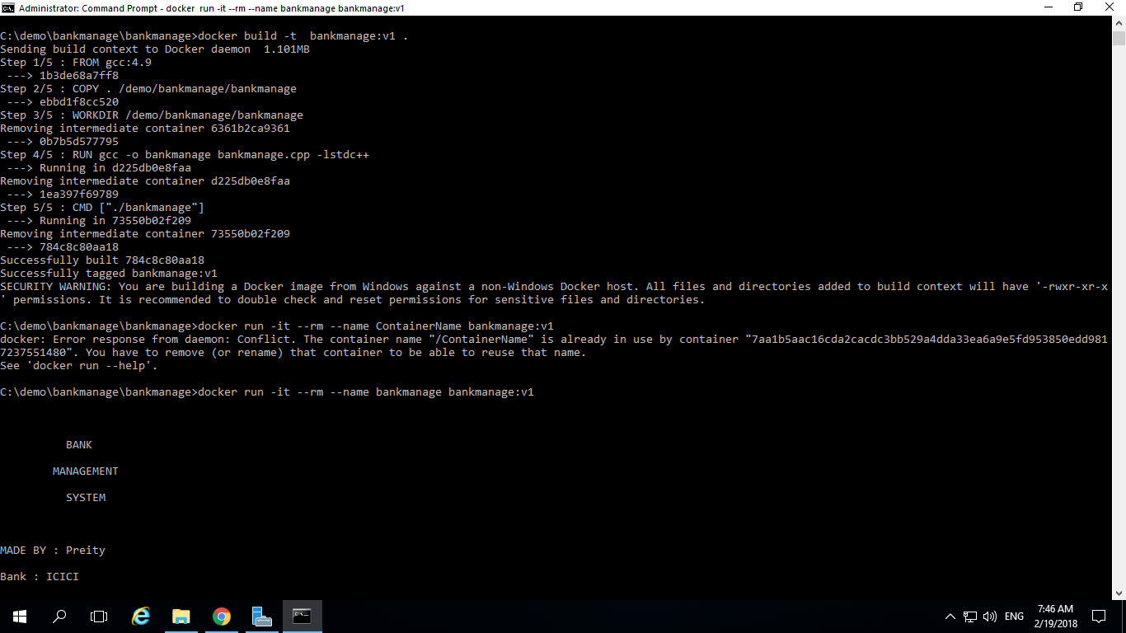
Notes:
To build an image, open command prompt and move to the location where ever, *.cpp file and Dockerfile is kept.
Now write a command,
docker build -t AppsName:v1 .
This command builds image, which can be seen through,
docker images command

Slide 8
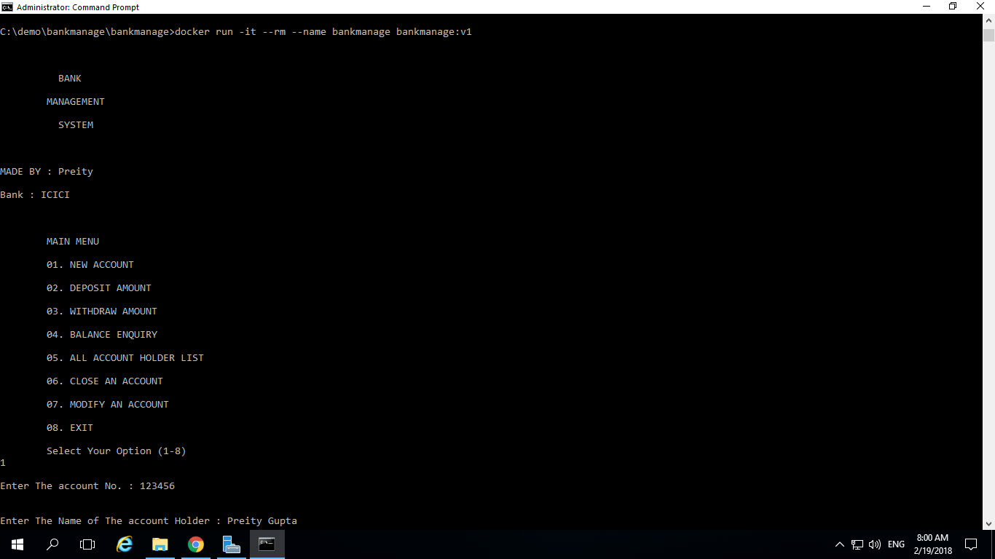
Notes:
To run an application, write a command,
docker run -it --rm --name ContainerName AppsName:v1 ,
,This command will execute an application in a container and after running an application, a container is automatically moves to exit mode.
To view a container, which is moved to exit mode write a command
docker ps –a

Slide 9
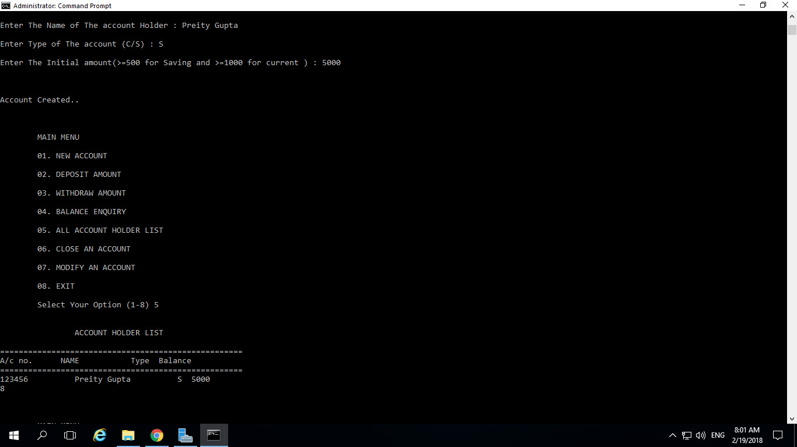
Notes:
Here it can be seen that new account is created
Similarly, Any type of C, C++ and VC++ application can be containerize to Azure VM with Docker support with enhanced performance, agility, availability and reliability.
To further automate the code analysis process, many static code analyser can be incorporated like

Slide 10
PLOYSPACE
ECLAIR
Detects run time errors, dead code
A platform for the automatic analysis, verification, testing and transformation of C and C++ programs.
VISUAL STUDIO
CPPLINT
Static code analysis for C/C++
An open-source tool that checks for compliance with Google's style guide for C++ coding
PRQA QA·C and QA·C++
AST
Deep static analysis of C/C++ for quality assurance with MISRA support.
Performs architecture checking, interface analyses, MISRA checking, and clone detection
FRAMA -C
KLOCWORK
An open-source static analysis framework for C
A static analysis tool for C/C++
ECLIPSE
FLUCTUAT
Static code analyzer.
Abstract interpreter for the validation of numerical properties of programs
Automation Tools
Notes:
Polyspaces, Visual Studio ,PRQA QA-C and QA-C++, FRAMA –C, ECLIPSE, ÉCLAIR, CPPLINT, ASTREE, KLOCWORK, FLUCTUAT
These tools detect runtime erros and dead code etc and assure quality with MISRA support.
This way, manual dependency can be reduces near to zero and precious time can be saved by logically grouping the provisioning requirements of these applications.
For detailed demo or more information, Contact us.
Thank you.

Slide 11


